Slide 2
Autonomous Vehicle Controls
Week 5
Lateral Vehicle Control

Slide 3
Recap :
In the previous week we
Saw how to implement longitudinal vehicle control to develop Adaptive Cruise Control feature
Implemented optimal control methods using LQR
Developed an Advanced ACC feature using platooning
Connected vehicle features

Slide 4
Table of Contents:
Lateral control
Introduction to Lateral Control
Boundary diagram
Type of control methods
Lateral Dynamics
Kinematic Bicycle model
Tire model
Dynamic Bi-cycle model
Feedback control system design

Slide 5
Learning objectives for this week
This week we will
Learn lateral vehicle control dynamics
Have an overview on various control methods available for lateral control
Implement a simple geometric based lateral controller

Slide 6
Lateral Control

Slide 7
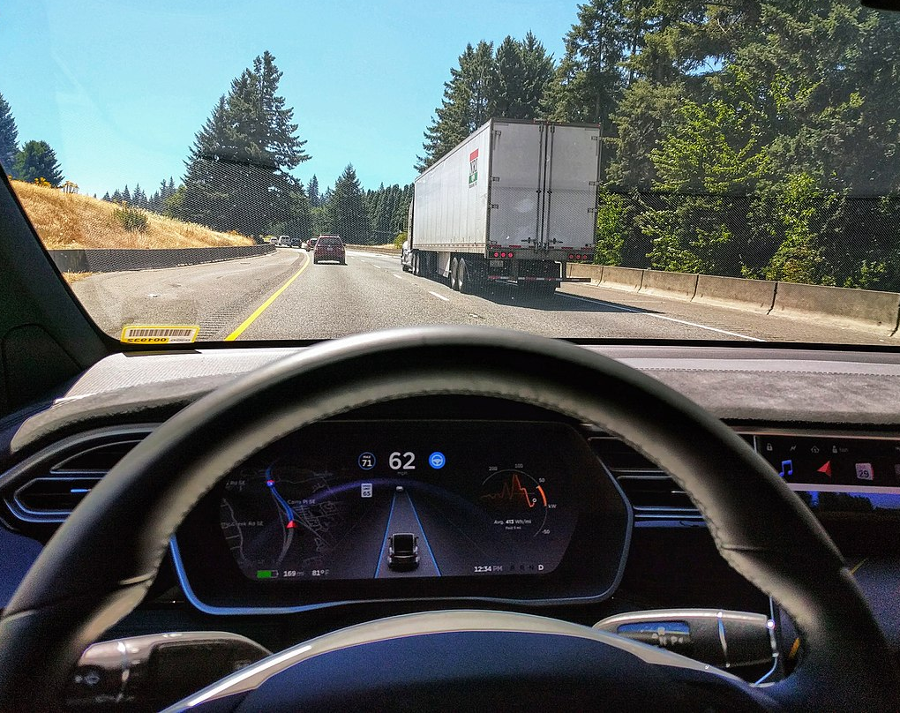
Introduction to Lateral Control
Lateral control methods are used to autonomously control the lateral motion of a vehicle (steering control).
Features include
Lane Keeping System (LKS),
Lane Centering Assist (LCA)
Lane change departure warning (LCWA).
In this course, we will build a Lane Centering Assist system to autonomously steer around a track
1

Slide 8
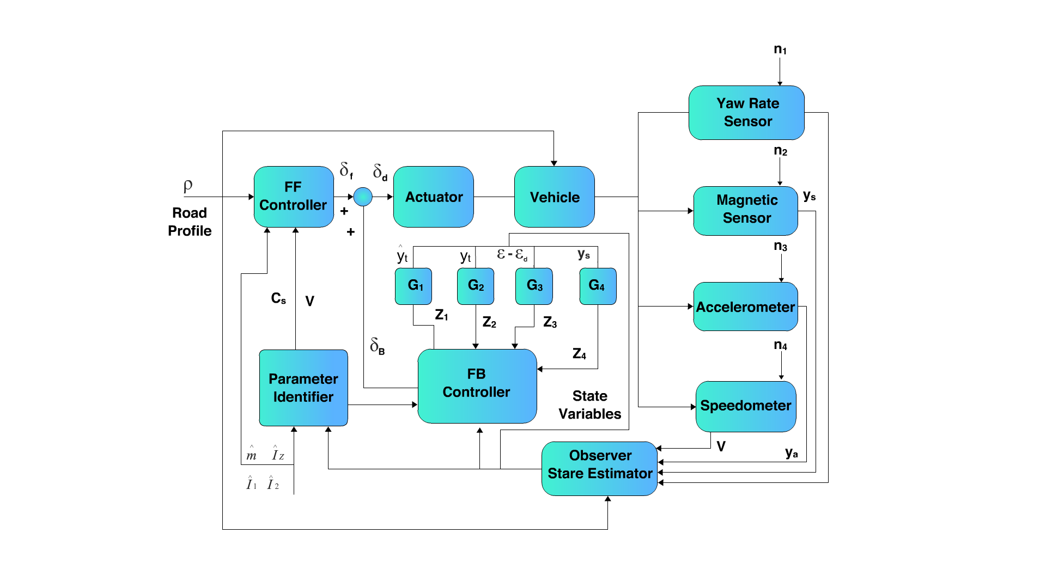
Boundary Diagram for LCA

Slide 9
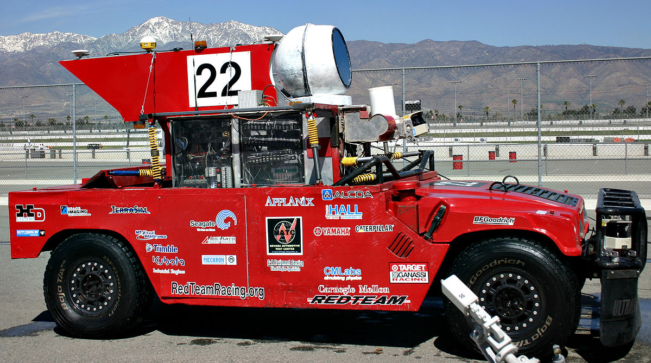
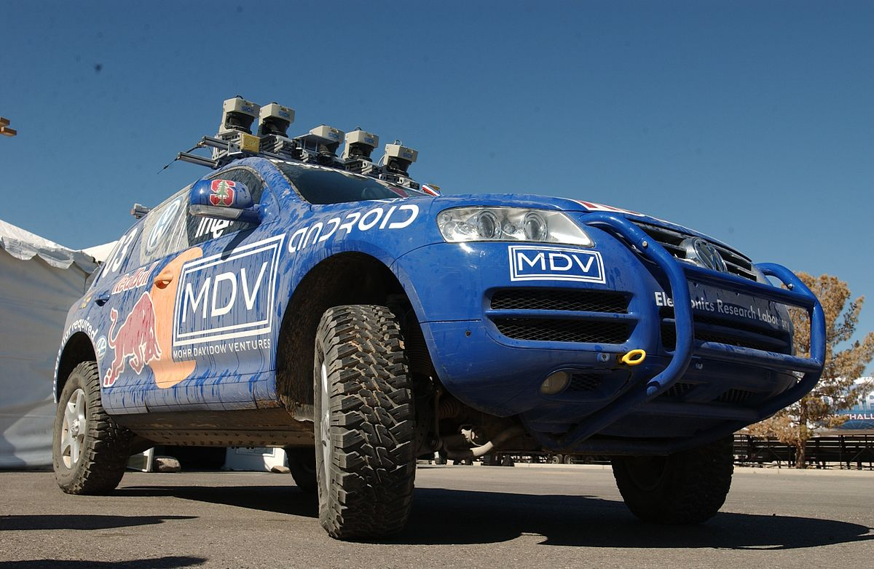
Lateral control methods
Geometric Path tracking methods exploit geometric relationships between vehicle and path to calculate control inputs.
Geometric Path tracking methods
Pure Pursuit controller
Stanley Controller
2
3

Slide 10
Pure Pursuit controller

Slide 11
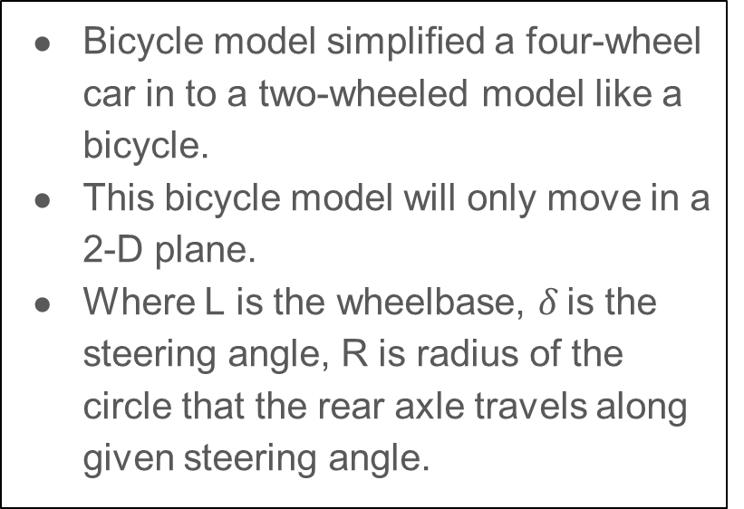
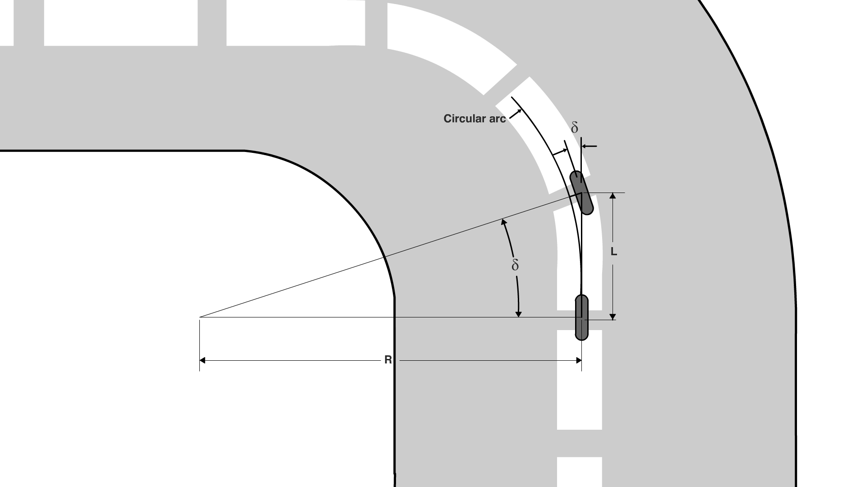
Pure Pursuit controller
Geometric Bi-cycle model
Notes:
A : Ask skill lync to create the diagram shown

Slide 12
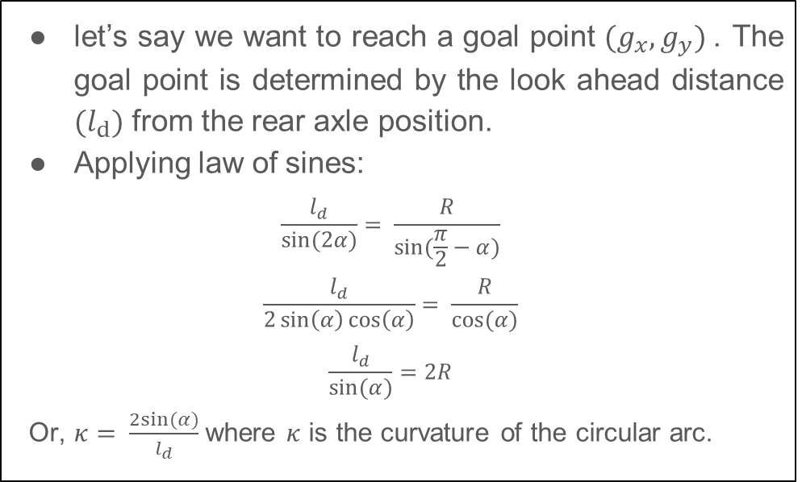
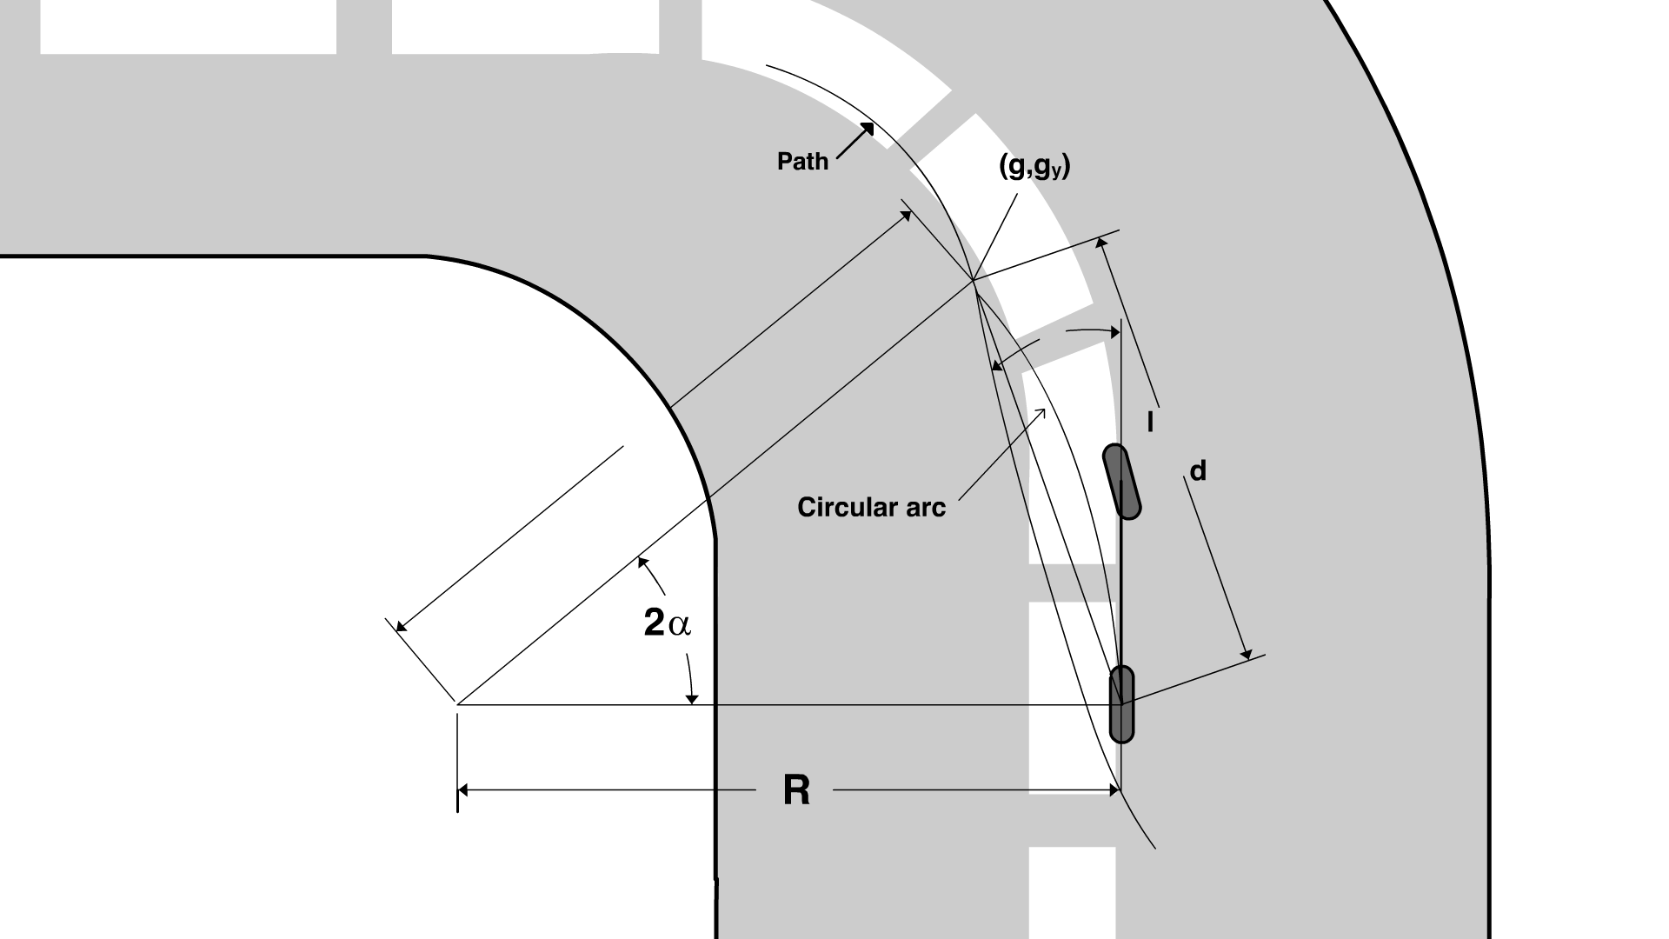
Pure Pursuit Geometry
Pure pursuit geometry

Slide 13
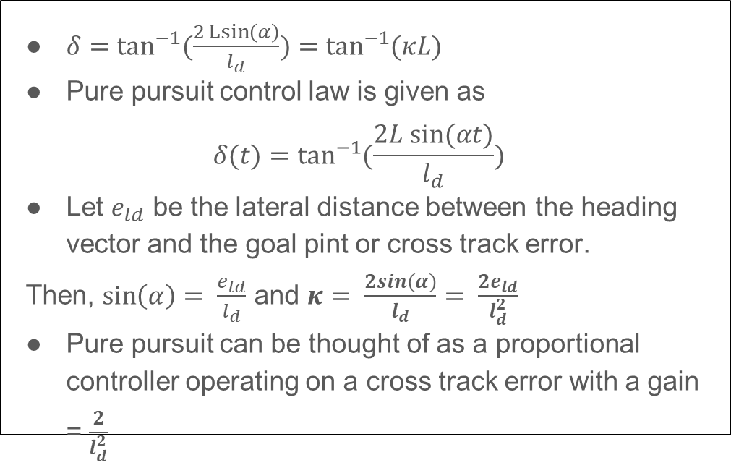
Pure Pursuit Geometry
Pure pursuit geometry

Slide 14
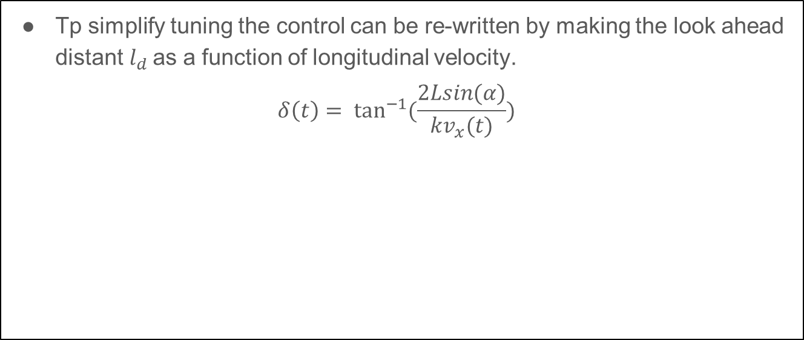
Pure pursuit tuning

Slide 15
Observations from Pure pursuit controller
A short look ahead distance provides smoother tracking, however a small look ahead causes a more oscillatory motion.
Longer look ahead distance results in less oscillations but large steady state errors.
Pure pursuit controller has more robustness to quick transient sections.

Slide 16
Observations from Pure pursuit controller
Limitations:
This type of controller is path dependent and needs to be tuned with the look ahead distance

Slide 17
Stanley Controller

Slide 18
Stanley Controller
This path tracking approach was used by the Stanford team in the Darpa grand challenge.
Main difference between Stanley controller and Pure pursuit is the point of reference.
In Stanley controller the front axle in the bi-cycle model is taken as reference to calculate the cross track error.
Stanley method geometry
Notes:
A : need SL to get the diagram for the geometry.

Slide 19
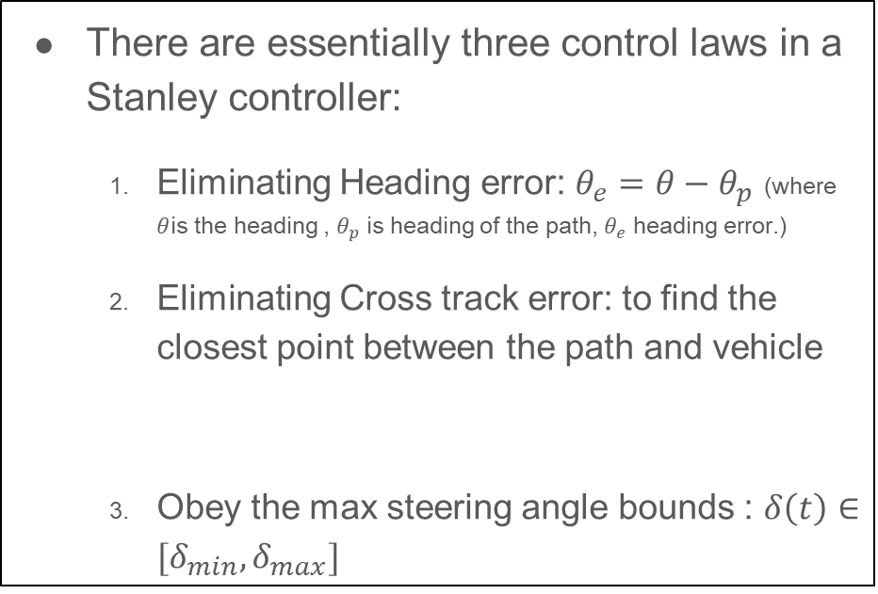
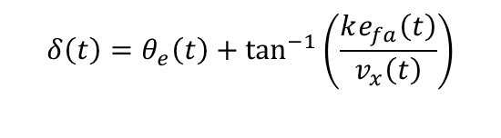
Stanley formulation
Stanley method geometry

Slide 20
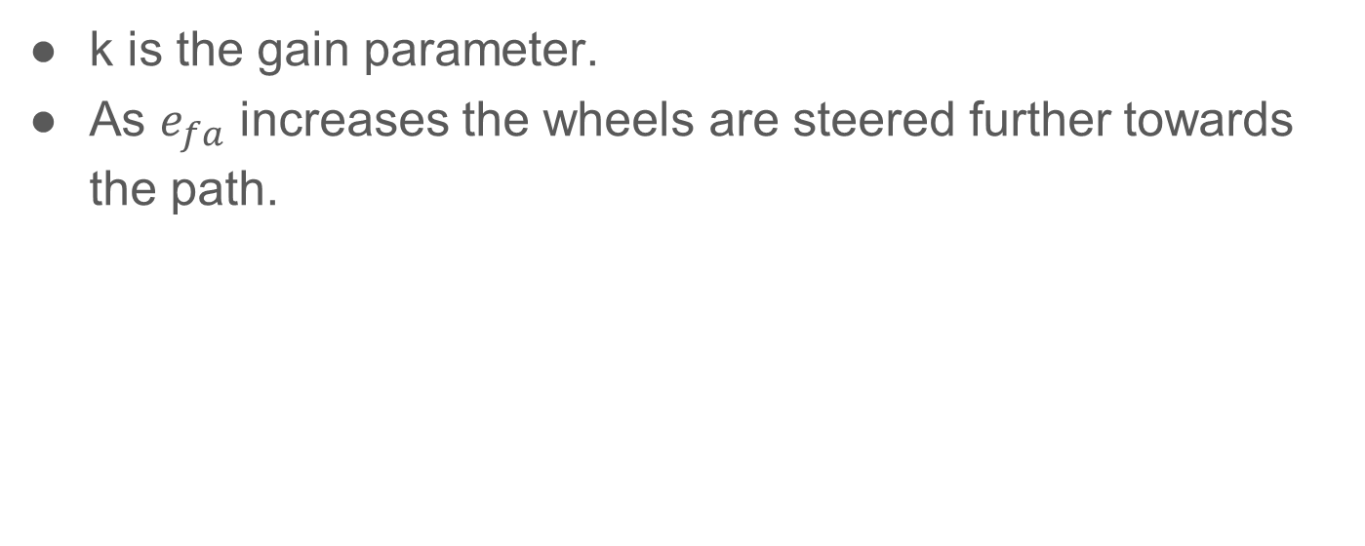
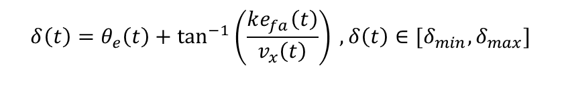
Stanley tuning

Slide 21
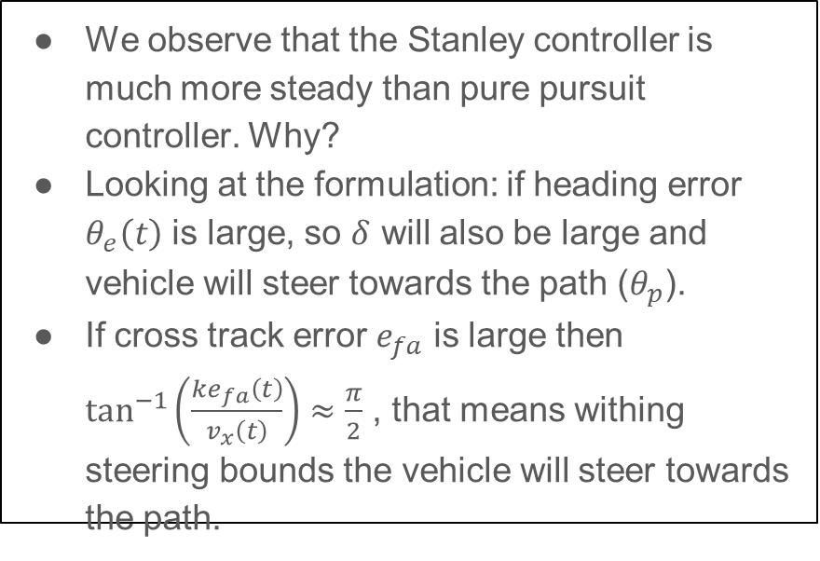
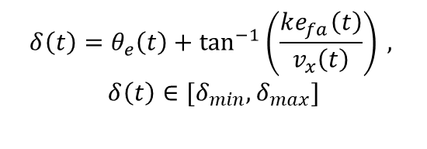
Stanley controller observations

Slide 22
Summary
In this week we learnt basic bicycle model dynamics.
We also implemented and experimented with 2 common robotic path tracking controllers Pure pursuit, Stanley controller.
In the next section we will be looking into more Dynamics based control methods and implement a lane centering assist feature.

Slide 23
Image Credits
Ian Maddox, CC BY-SA 4.0 <https://creativecommons.org/licenses/by-sa/4.0>, via Wikimedia Commons
CC BY-SA 3.0, https://commons.wikimedia.org/w/index.php?curid=307824
Public Domain, https://commons.wikimedia.org/w/index.php?curid=2807954

Slide 24
THANK YOU

